Slide 1
Introduction to Big Data

Slide 2
Module 1: Course Introduction

Slide 3

1.1 Course Welcome
3

Slide 4
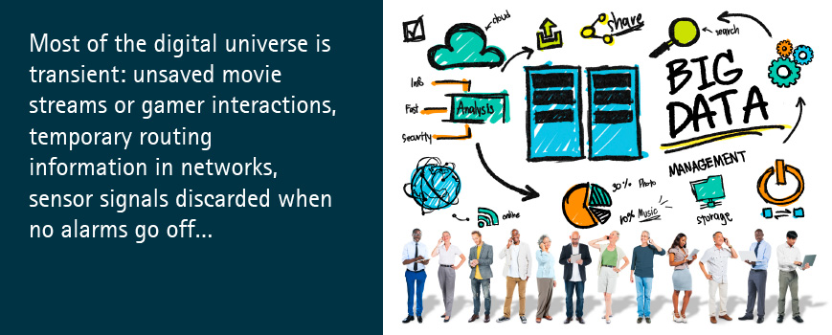
4

Slide 5
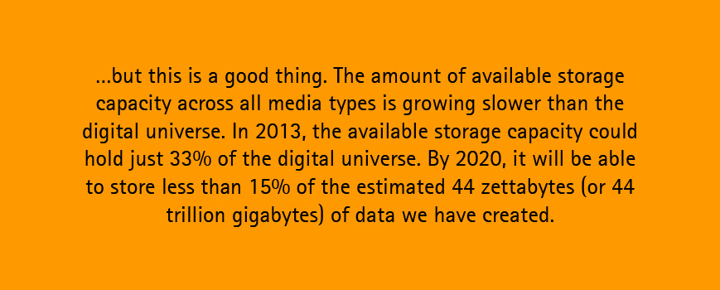
5

Slide 6
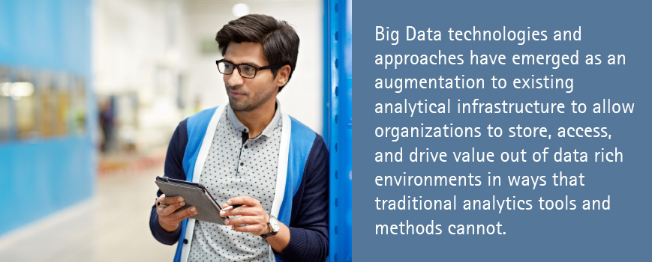
6

Slide 7

7

Slide 8
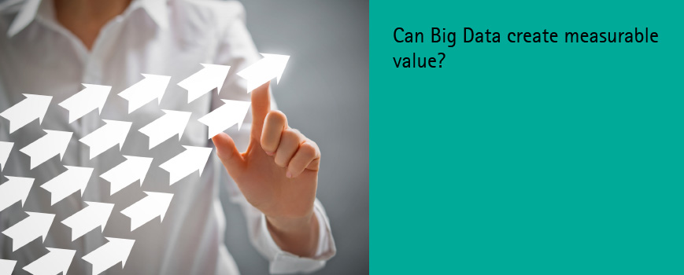
8

Slide 9
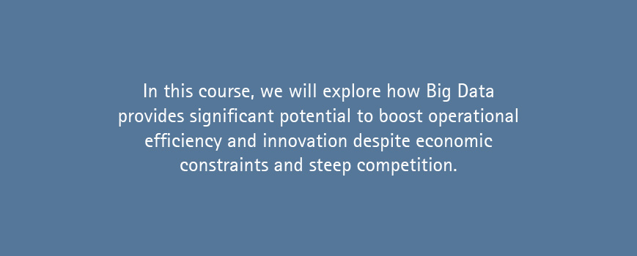
9

Slide 10

10

Slide 11

1.2 Course Overview
By the end of this course, you will be able to:
Describe the concept of Big Data and the value it can bring to clients
Give examples of how Big Data is applied across various industries
Describe the various types of technologies that support Big Data
Articulate how managing and generating insights from Big Data differs from traditional data and analytics approaches
Discuss Accenture’s approach to Big Data
This course is divided into six modules:
Module 1: Course Introduction
Module 2: Understanding Big Data and its Applications
Module 3: Big Data Technologies
Module 4: Working with Big Data
Module 5: Accenture's Approach to Big Data
Module 6: Course Conclusion
11

Slide 12
Module 2: Understanding Big Data and its Applications

Slide 13
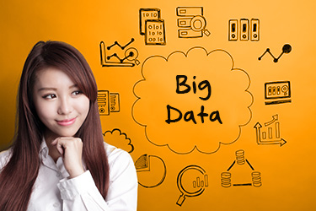
2.1 Module Introduction
Big Data are data sets so large or so complex that traditional methods of storing, accessing, and analyzing their breakdown are too expensive. However, there is a lot of potential value hidden in this data, so organizations are eager to harness it to drive innovation and competitive advantage.
Big Data technologies and approaches are used to drive value out of data rich environments in ways that traditional analytics tools and methods cannot.
By the end of this module, participants will be able to:
Define Big Data by its differentiating characteristics
Provide several examples of Big Data
Articulate the value organizations can achieve by harnessing Big Data
Identify industry trends and examples relevant to Big Data
Recognize common challenges organizations face in working with Big Data
13

Slide 14
2.2 The Changing World of Data
Organizations carry out business based on insights gained from data analysis, but there has been a shift in the size, type, and form of data and in the way that data is analyzed. Let’s begin by looking at the drivers that are causing this shift.
Data Explosion | Unstructured data is doubling every three months In 2014, the digital universe equaled 1.7 megabytes per minute for every person on Earth By 2015, the number of networked devices was twice the global population In 2016, the level of connectivity related to products, assets, and processes will increase 50% for all industry value chains Ongoing digital transformation: Successful digital transformation must include solutions for warehousing all accumulated Big Data By the end of 2017, two thirds of the CEOs of the G2000 enterprises will have digital transformation (DX) at the center of their corporate strategy By 2020, data from embedded systems (the signals from which are a major component of the Internet of Things) will grow from 2% of the digital universe (as of 2013) to 10%
Monetization | Enterprise data monetization services continue to grow Large retailers are monetizing their own data to provide insights to suppliers
Data Mobilization | Novel approaches to analyze unstructured data are shortening the time to move from data to insight Shift toward data consumption in multiple environments (business applications, mobile, social)
Social Media | Emergence of companies that scrub and aggregate data from social media and blogs Greater focus on data that provides insight into a customer’s digital persona
Technology Advancement | Commodity priced storage and compute Emergence of open source and Big Data technologies to solve production problems at scale
Data-Led Innovation | De-coupling data from applications Disparate external data is shaping context Cost effective mobilization of massive scale data

Slide 15
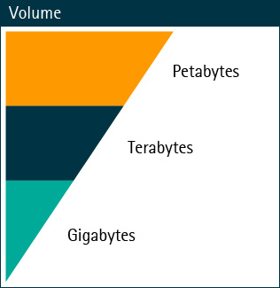
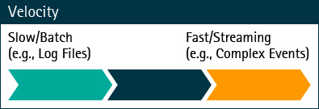
2.3 Big Data Characteristics (1/2)
The majority of data generated today, an estimated 85% in fact, is unstructured. This includes email, video, blogs, call center logs, and social media. This amount of data requires fluid frameworks and a flexible architecture that can increase computing capacity and lead to easier data modeling, exploration, and maintenance. Understanding the types of data that you are working with is important to conquering the challenges it presents. We differentiate Big Data from traditional data by one or more of the three V’s: Volume, Velocity, and Variety.
Volume is the sheer amount of data generated that must be understood to make data-based decisions. These decisions are driven by increasing data sources and higher resolution devices.
Velocity measures how fast data is produced and modified and the speed with which it needs to be processed. An increased number of data sources, improved connectivity, and the enhanced power of data generating devices drives velocity.
15

Slide 16
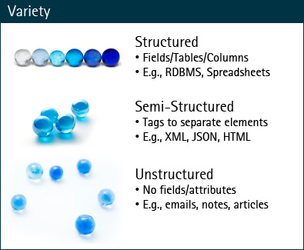
2.3 Big Data Characteristics (2/2)
Variety defines data coming from new sources—both inside and outside of an enterprise—creating integration, management, governance, and architectural pressures on Information Technology.
Structured data is typically found in tables with columns and rows of data. The intersection of the row and the column in a cell has a value and is given a “key,” which it can be referred to in queries. Because there is a direct relationship between the column and the row, these databases are commonly referred to as relational databases. A retail outlet that stores their sales data (name of person, product sold, amount) in an Excel spreadsheet or CSV file are examples of structured data.
Semi-structured data also has an organization, but the table structure is removed so the data can be more easily read and manipulated. XML files or an RSS feed for a webpage are examples of semi-structured data.
Unstructured data is found everywhere: text messages, emails, and social media for example. Unstructured data generally has no organizing structure, and Big Data technologies use different ways to add structure to this data.
16

Slide 17



2.4 Sources of Big Data
So where is all of this Big Data coming from? Data typically originates from one of three primary sources: the internet/social networks, traditional business systems, and increasingly from the Internet of Things. The data from these sources can be structured, semi-structured, or unstructured, or any combination of these varieties. For example, data produced as a result of business activities can be recorded in structured or unstructured databases, while electronic files generally refer to unstructured documents which are stored or published as electronic files, like Internet pages, videos, or PDF files.
Social Networks
Traditional Business Systems
Internet of Things
Social Networks provide human-sourced information from:
Social Networks: Facebook®, Twitter®, Tumblr®, etc.
Blogs and comments
Personal documents
Pictures: Instagram®, Flickr™, Picasa™, etc.
Videos: YouTube™, etc.
Internet searches
Mobile data content (text messages)
User-generated maps
E-Mail
Commercial transactions
Banking/stock records
E-commerce
Credit cards
Medical records
Sensors: traffic, weather, mobile phone location, etc.
Security, surveillance videos, and images
Satellite images
Credit cards
Medical records
Data from computer systems (logs, web logs, etc.)
17

Slide 18






2.5 Big Data Examples by Data Type
Big Data has applications for various data types. Visit the resources page in this course for links to additional Big Data application examples.
By counting the cars in a parking lot, analysts are able to predict a company’s customer flow.
Video data analysis identifies risks and provides real-time alerts.
Infrared images capture chlorophyll in plants, and microwave images pick up the degree of moisture in the crops.
Twitter® feeds can foretell changes to the Dow Jones with 86.7% accuracy.
Speech analytics methods are used to identity unsatisfied customers.
Tracking newspaper clippings for injury surveillance provides early alerting to insurance companies.
18

Slide 19
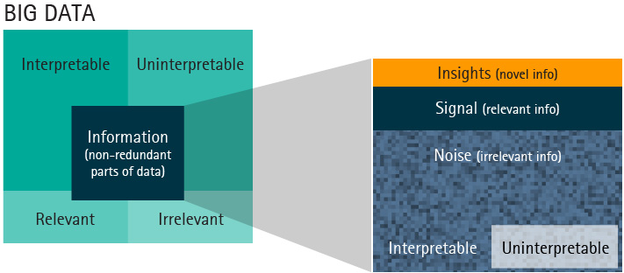
2.6 From Data to Insights
When the data you capture and crunch is large and disorderly, irrelevant bits (often called “noise”) may come along for the ride. The IDC estimates that 5% of useful data is “target rich,” and that percentage should nearly double by 2020 as organizations take advantage of new tools and data sources. Curious scientists and data analysts are tasked with determining what this "noise" means and if it is significant. Now, imagine the data in question has come as a result of capturing data for a business. What useful noise might it contain? What opportunities for business development, loss prevention, cost reduction, and especially supply chain planning might exist?
Image from: http://techcrunch.com/2012/11/25/the-big-data-fallacy-data-≠-information-≠-insights/
19

Slide 20
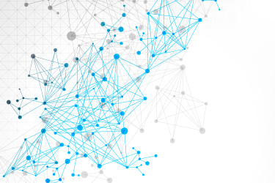
2.7 Challenges Adopting Big Data
This rapid shift in the data world has left organizations struggling with traditional infrastructure, technologies, and information management. Information producing devices such as sensors, tablets, and mobile phones continue to multiply, and such information sharing options represent a tremendous challenge to organizations looking to benefit by using traditional processing techniques. As a result, traditional approaches have come under pressure.
Challenges adopting Big Data include:
Relational approaches are not optimum when dealing with a lack of structure, speed of processing at scale, and associated cost.
Data visualization and analytics resources are not able to deal with the right representations and insights that users can efficiently discover from Big Data.
Traditional information governance and management practices cannot cope with the characteristics of Big Data.
Many organizations lack the necessary architecture, analytics skills, and talents to benefit from the shift.
Application silos create a handicap in effectively enabling business with comprehensive information.
The economics of data are based on the idea that value can be extracted through analytics. Big Data is changing the way analytics were commonly viewed, from data mining to Advanced Analytics. It is also important to note that Big Data Analytics and Business Intelligence are related, but they aren’t the same. Big Data Analytics is not another BI initiative, rather it builds upon existing BI. Big Data Analytics is about extracting valuable insight from data, not about transforming data into information through dashboards and reports.
20

Slide 21
2.8 Big Data Barriers (1/3)
As more and more organizations leverage Big Data, we need to understand the barriers that potentially inhibit adoption when not addressed properly. All of the terms below are indications for why a company needs to be data-driven. Large doesn't have to mean size, it doesn't need to just be unstructured data, and value isn't only in social media data. The value is in the data itself and how it can be combined with other data to drive insights in everything from customer experience to improved supply chain operations.
Data Policies | Data policy barriers are caused by concerns around privacy, liability, sensitivity, and intellectual property. Data privacy is an ever-growing issue—particularly with consumers—as more and more contextual data becomes available for use. Unless privacy issues are understood and compliance policies are established and ratified, organizations may remain conservative in leveraging the full potential of Big Data. There are also security concerns at this scale driven by the need to protect sensitive information hidden in Big Data. Intellectual properties associated with data, ownership issues, and consequences due to data inaccuracies and associated liabilities all need to be thought through before mainstream adoption.
Skills | A lack of skills to support data science, visualization, and solution development create a significant barrier to the adoption of Big Data. Growing innovation and computing efficiencies lead to the introduction of new analytical techniques and solutions; however, many organizations do not have the talent to drive this innovation, the ability to architect solutions, or the resources to analyze data to produce actionable insights.
21

Slide 22
2.8 Big Data Barriers (2/3)
Tools and Technologies | Big Data requires the right tools and technologies to converge architectures for compatibility and to ensure successful integration. To gain the most out of Big Data, some new and emerging technologies need to be deployed. Traditional technologies should be evaluated for potential co-existence solutions. This is not an easy process and it depends a great deal on how mature an organization is in dealing with new technologies and converging them with existing ones.
Big Data Myths | Data access and availability, ownership, and data quality are all potential barriers to Big Data adoption. Information management and governance processes and approaches need to be re-examined for appropriateness in the context of Big Data. Common Big Data myths need to be well understood to stay on the right track while dealing with these challenges. These myths include: Big Data is just about unstructured data. Big Data adoption is only necessary to handle huge volumes of data. Big Data is an IT problem. Big Data is only for internet companies. Big Data eliminates the need for RDBMS. Big Data is all about data scientists. The truth is Big Data is not just about data without a traditional relational structure. It is also not just about the volume. The challenge is that data is coming from so many different places. Clients will ask, “Do I need it? Is it valuable? How do I combine it with data I already have?”
22

Slide 23
2.8 Big Data Barriers (3/3)
Organizational Change | Big Data is about driving organizations to be data-centric, to provide incentives, and to promote sharing and collaboration. Internal policies that reflect guidelines for antiquated technologies can be in stark contrast to the nature of uses for Big Data, such as using open source tools, moving data into the cloud, security measures, etc.
23

Slide 24
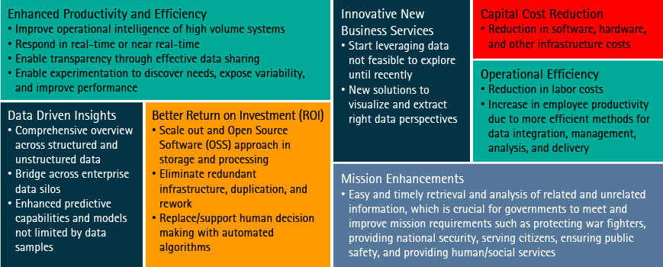
2.9 Potential Value of Big Data
What benefits can Big Data really bring? Can Big Data create measurable value to the enterprise? The answer is yes! The data has always been a part of the impact to an enterprise. Now the scale and scope of value that data can bring has expanded as the availability of data converges with the ability to harness it and the ability to afford to do so. Big Data provides significant potential to boost the operational efficiency and innovation in an enterprise at a time of economic constraints and steep competition.
24

Slide 25
2.10 Checkpoint
Which of the following statements about Big Data are correct?
Select all that apply, and click or tap the Submit button. There will be more than one correct answer.
Big Data is just about unstructured data
Big Data adoption is only necessary to handle huge volumes of data
Big Data are data sets so large or so complex that traditional methods of storing, accessing, and analyzing their breakdown are too expensive
Big Data technologies and approaches are used to drive value out of data rich environments
25

Slide 26
2.10 Checkpoint Answer
Which of the following statements about Big Data are correct?
Select all that apply, and click or tap the Submit button. There will be more than one correct answer.
Big Data is just about unstructured data
Big Data adoption is only necessary to handle huge volumes of data
Big Data are data sets so large or so complex that traditional methods of storing, accessing, and analyzing their breakdown are too expensive
Big Data technologies and approaches are used to drive value out of data rich environments
The correct answers are C and D.
Big Data is not just about data without a traditional relational structure, and it is not just about the volume. Big Data are data sets so large or so complex that traditional methods of storing, accessing, and analyzing their breakdown are too expensive. However, there is a lot of potential value hidden in this data, so organizations are eager to harness it to drive innovation and competitive advantage. Big Data technologies and approaches are used to drive value out of data rich environments in ways that traditional analytics tools and methods cannot.
26

Slide 27
2.11 Big Data Use Cases
Big Data application use cases across industries are broadly classified into four areas: converging unstructured data, low-cost storage and processing, advanced analytics and visualization, and real-time business intelligence.
Converging Unstructured Data | Los-Cost Storage and Processing
Log Processing Firewall activity Image processing Video processing Seismic processing | Move Extract Transform Load (ETL) into parallel environment Join Enterprise Data Warehousing (EDW) with unstructured data sources Pre-process EDW
Advanced Analytics and Visualization | Real-Time Business Intelligence
Model the individual user Cross enterprise data sets Data Science | Sensor data analysis Network analysis Enterprise Monitoring Reshape organizational structure/direction through new insight
27

Slide 28
2.12 Industry Trends
Big Data is used in every industry and impacts core business processes.
Resources | Public Sector | Financial Services
Upstream oil and gas companies monitor 40,000 sensors per asset combined with 4D seismic imagery to drive real-time production operations, maintenance, and reliability programs. | The United States Postal Service (USPS) applies unique barcodes so it can seamlessly induct and account for postage. This results in approximately 1 billion pieces per day, scanned multiple times throughout the supply chain. | Capital market firms are pioneers in the Big Data space and continue to innovate around low latency systems to unlock trading arbitrage opportunities.
Health | Retail | Communications
Electronic health records, home health monitoring, telehealth, and new medical imaging devices drive data deluge in a connected health world. | Emerging location-based data, group purchasing, and online leads allow retailers to continuously listen, engage, and act on customer intent across the purchasing cycle. | Mobile usage data for service providers unlocks new business models and revenue streams, from outdoor ad placement to medical adherence.
28

Slide 29

2.13 Big Data Implementation Examples
Various organizations have implemented Big Data:
Google™ used Big Data to enable web-scale searches on massive data in an innovative way, such as estimating flu activity around the globe.
The University of Ontario Institute of Technology used Big Data to collect 100 million data points per day for premature babies to correlate sickness with vitals, allowing for early action.
Tennessee Valley Authority used Big Data to analyze 1.5 million smart grid data points to analyze power grid anomalies for unprecedented efficiencies.
American Express® used Big Data to retain customers by understanding social relationships.
NetApp® used Big Data to build their auto support system (known as ASUP) that enables proactive issue identification and alerting on their devices before customers notice the issue.
General Motors® used Big Data to support Global Positioning System (GPS) and telemetry data to track driving habits, reduce insurance, and increase retention.
Visit the resources page in this course for links to additional Big Data application examples.
29

Slide 30
2.14 Checkpoint
True or False: The rapid shift in the size, type, form, and way that data is analyzed has left organizations struggling with traditional infrastructure, technologies, and information management.
Select the correct option, and click or tap the Submit button.
True
False
30

Slide 31
2.14 Checkpoint Answer
True or False: The rapid shift in the size, type, form, and way that data is analyzed has left organizations struggling with traditional infrastructure, technologies, and information management.
Select the correct option, and click or tap the Submit button.
True
False
The correct answer is TRUE.
Information producing devices such as sensors, tablets, and mobile phones continue to multiply, and such information sharing options represent a tremendous challenge to organizations looking to benefit by using traditional processing techniques. As a result, traditional approaches have come under tremendous pressure.
Challenges adopting Big Data include:
Relational approaches are not optimum when dealing with a lack of structure, speed of processing at scale, and associated cost.
Data visualization and analytics resources are not able to deal with the right representations and insights that users can efficiently discover from Big Data.
Traditional information governance and management practices cannot cope with the characteristics of Big Data.
Many organizations lack the necessary architecture, analytics skills, and talents to benefit from the shift.
Application silos create a handicap in effectively enabling business with comprehensive information.
31

Slide 32

2.15 Module Summary
The following key points were covered in this module:
There has been a shift in the size, type, and form of data and in the way that data is analyzed.
We differentiate Big Data from traditional data by one or more of the three V’s: Volume, Velocity, and Variety.
Big Data generally comes from social networks, traditional business systems, or the Internet of Things.
Organizations using traditional processing techniques are struggling to benefit from the onslaught of Big Data.
Data policies, skills, tools and technologies, data management, and organizational change are potential barriers to Big Data adoption.
Big Data can provide significant potential value including:
  Enhanced productivity and efficiency
  Data driven insights
  Better return on investment (ROI)
  Innovative new business services
  Capital cost reduction
  Operational efficiency
  Mission enhancements
Big Data application use cases across industries are broadly classified into four areas: converging unstructured data, low-cost storage and processing, advanced analytics and visualization, and real-time business intelligence.
Big Data impacts core business processes in every industry: resources, public sector, financial services, health, retail, and communications.
Big Data technologies can be used to organize imagery, multimedia, text, and other unstructured data.
32

Slide 33
Module 3: Big Data Technologies

Slide 34
3.1 Module Introduction
Big Data requires exceptional technologies to quickly and efficiently process large quantities of data. A significant number of new technologies have emerged to harness and address Big Data. While many of these technologies are still immature, they are evolving quickly.
There are seven primary needs that Big Data technologies address:
Distributed Storage and Processing
Low latency Non-Relational database (DB)
Streams and Complex Event Processing
Specialty Data Types
In-memory DB and Processing
Analytics DB and Appliances
Presentation and Reporting Layer
Modern data technologies often specialize in one or two of these capabilities, while successful enterprises use a combination of technologies to put together a comprehensive business solution.
By the end of this module, you will be able to describe and give examples of technologies that support each of these capabilities.
34

Slide 35
3.2 Processing Big Data
Several vendors support data storage and processing needs. Google® pioneered a software framework called Hadoop for processing petabyte-scale volumes of multi-structured data. Hadoop is a collection of integrated cloud services—analytics, computing, database, mobile, networking, storage, and web—for moving faster, achieving more, and saving money. Servers are currently dominated by pure play, open source commercial vendors such as Cloudera® and Hortonworks®. Larger commercial firms see the potential to hook up with IBM® and Oracle® and their products. Cloud-based solutions are available from Amazon Web Services®.
Characteristics | Differences
Distributed fault-tolerant file system and massive data processing across a cluster of commodity servers Batch processing primarily for throughput, not response time New frameworks allow for real-time data processing that can deliver rapid results | Horizontal scalability of storage and processing on a variety of infrastructures Highly efficient large-scale processing with shared nothing architecture Lowered cost of ownership through commodity hardware and open source
Uses | Products/Vendors
Avoid data regret and store/consolidate years of raw data at a low cost Avoid commercial licensing costs for storing and processing huge volumes of data Use as a low-cost data sandbox for Business Intelligence (BI) Use as a pre-processing engine for raw data ahead of a data warehouse | Hadoop®, YARN, Cassandra, NoSQL, and Spark™ Cloudera®, DataStax®, Hortonworks®, Databricks™, and IBM® BigInsights™ Amazon Web Services (AWS)™, Microsoft® Azure, and Google™ Cloud Platform
35

Slide 36
3.3 Storing Big Data
Apache® Hadoop® is one of the leading frameworks for data storage. Each of the following frameworks address different Big Data storage requirements.
Hadoop® | Hadoop® Distribution and Ecosystem
The Apache® Hadoop® software library is a framework that allows for the distributed processing of large data sets across clusters of computers using a simple programming model. Hadoop® scales linearly, in that multiplying the number of hosts in your cluster cuts computation time proportionately. | The Hadoop® Distribution and Ecosystem framework is a collection of tools over HDFS/MapReduce, sometimes distributed by a vendor, for building Big Data applications.
HDFS | MapReduce
HDFS is a distributed, fault-tolerant file system used to back the computation of Big Data. | MapReduce​ is a distributed, fault-tolerant, parallel programming paradigm.
36

Slide 37
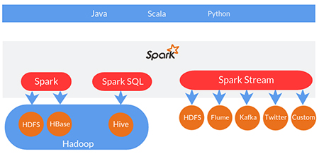
3.4 Apache® Spark™
The Spark™ framework performs general data analytics on distributed computing clusters like Hadoop®. It provides in-memory computations for increased speed and data processing over MapReduce. It runs on top of an existing Hadoop® cluster, can access the Hadoop® data store (HDFS), and can process structured data in Hive™ and streaming data from sources such as HDFS, Apache® Flume™, Kafka, and Twitter®.
Apache Spark™ features include:
Speed: With Spark™, applications in Hadoop® clusters run up to 100 times faster in memory, and 10 times faster when running on disk.
Ease of Use: Spark™ lets you quickly write applications in Java®, Scala, or Python™.
Combines SQL, Streaming, and Complex Analytics: In addition to simple “map” and “reduce” operations, Spark™ supports SQL queries, streaming data, and complex analytics such as machine learning and graph algorithms out-of-the-box.
Runs Everywhere: Spark™ is designed to run on different platforms like Hadoop® or Apache® Mesos™. It can also run standalone or in the cloud. Spark™ can access HDFS, Cassandra, HBase™, S3®, and other various data sources.
37

Slide 38
3.5 Comparing Spark™ and MapReduce
Let’s take a closer look at how MapReduce and Spark™ compare:
Faster Performance: Spark™ handles batch-processing jobs up to one hundred times faster than MapReduce. It simply cuts down the number of treads and writes to the disc.
Management Made Easy: Spark™ allows users to perform streaming, batch processing, and machine learning in the same cluster. This simplifies data processing and makes the infrastructure easier to manage.
Real-time Stream Processing: Hadoop® MapReduce typically processes stored data, but Spark™ enables real-time data modification through Spark™ Streaming.
Caching: Spark™ caches partial computation results across its memory of distributed workers, which ensures lower latency computations. MapReduce computations are completely disk oriented.
Easy to Use: Writing Spark™ code is more compact when compared to MapReduce.
Consult the table below for a summary comparison of MapReduce and Spark™.
Hadoop® MapReduce | Apache® Spark™
Data that does not fit in the memory | Better performance for data that fits in the memory, particularly on dedicated clusters
Economical option because of the Hadoop®-as-a-service offering (HaaS) and the availability of more personnel | More cost effective (aside from expensive staffing)
More failure tolerant | Failure tolerant
MapReduce requires core Java® programming skills; however, there are several utilities that make programming in Hadoop® MapReduce easier | Programming is easier as it has an interactive mode
38

Slide 39
3.6 Low-Latency Non-Relational Databases
Because of its sheer size and lack of structure, traditional relational-based databases (RDBMS) cannot handle Big Data. Big Data requires a more flexible non-relational structure that supports fast access to data for processing. There is no NoSQL database that can meet this need.
Characteristics | Differences
Non-relational (more popularly Not only SQL (NoSQL)) database Horizontal scaling and flexible data model definitions Relax rigidities of ACID (atomicity, consistency, isolation, durability) features in a Relational Database Management System (RDBMS) Distributed and designed for large-scale data storage and massively-parallel data processing across a large number of commodity servers | Achieve speed at scale, overcoming RDBMS limitations and inefficiencies Built-in high-resiliency architecture Dynamic modeling to support changing data profiles
Uses | Products/Vendors
Dynamic, semi-structured data for low-latency applications Real-time updates, retrieval, or user-facing web applications Examples of companies using NoSQL: Netflix®, Facebook®, LinkedIn® | Key Value (K-V), Column-Oriented, Document Databases Cassandra, Accumulo™, MongoDB®, Amazon® Dynamo DB
39

Slide 40
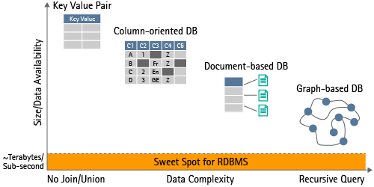
3.7 Non-Relational Databases
Non-relational databases have special features to handle Big Data.
Relational databases are predefined, expensive to scale, and have high storage costs. They are also transactional, consistent, and use mature SQL and a relational mindset.
On the other hand, non-relational (NoSQL) databases are flexible, scalable, and resilient. They feature commodity storage, are not transaction-oriented, and are eventually consistent. Non-relational databases are also programmable and SQL-like and use a new mindset.
Key Value Pairs
Based on Amazon® Dynamo approach
Simplistic key-value pairs
Examples: Dynomite, Voldemort, Tokyo
Column-Oriented DB
Big table clones
Based on Google’s™ BigTable approach
Columns are grouped by related data
Examples: Cassandra, HBase™
Document-Based DB
Inspired by Lotus Notes®
Collections of documents or data objects
Examples: CouchDB™, MongoDB®
Graph-Baed DB
Inspired by graph theory
Data structured in graphs rather than in tables
Examples: Neo4j®, AllegroGraph®
40

Slide 41
3.8 Streams and Complex Event Processing
A major component of Big Data is streaming, event-based data such as news stories, social media posts, or stock market feeds. The goal of complex event processing is to monitor and analyze this streaming data in order to identify and respond to changing circumstances in real-time.
Characteristics | Differences
Huge volume of continuously streaming data, complex event processing ACID (atomicity, consistency, isolation, durability) compliance for real-time transactions (TX) Structured Query Language (SQL) or NoSQL, real-time querying and search | Large-scale disparate data ingestion for storage and analysis High-volume of continuous data consumption and real-time search Consolidation of real-time events and dissemination to large number of clients
Uses | Products/Vendors
Online web portals for real-time ads and promotions Respond in real-time to events and changing requirements Continuous data analysis and rapid adaptation to changing data forms and types Tailor responses to unpredictable changes | GemFire®, Espertech, SenseiDB, Sensage®, Zoie, IBM® InfoStreams, uCIRRUS Apache® Flume™, Splunk®, Sumo Logic®, STORM, Kafka, Spark™ Streaming
41

Slide 42
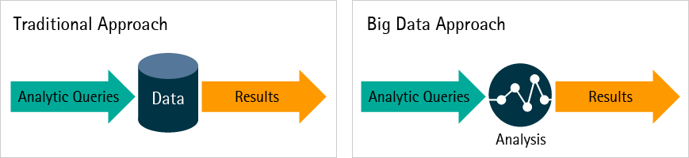
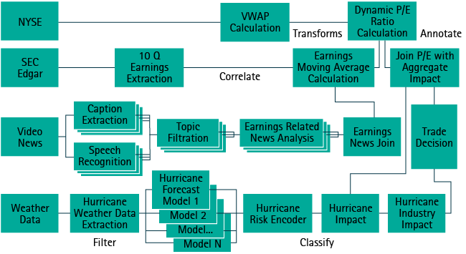
3.9 Processing Streaming Data
The diagram pictured shows different approaches to data processing: traditional and Big Data. In the traditional approach, data was stored and then analyzed. In the Big Data approach, streaming data is analyzed in real-time.
42

Slide 43
3.10 Checkpoint
True or False: Because of its sheer size and lack of structure, traditional relational-based databases (RDBMS) cannot handle Big Data.
Select the correct option, and click or tap the Submit button.
True
False
43

Slide 44
3.10 Checkpoint Answer
True or False: Because of its sheer size and lack of structure, traditional relational-based databases (RDBMS) cannot handle Big Data.
Select the correct option, and click or tap the Submit button.
True
False
The correct answer is TRUE.
Because of its sheer size and lack of structure, traditional relational-based databases (RDBMS) cannot handle Big Data. Big Data requires a more flexible non-relational structure that supports fast access to data for processing. Keep in mind that there is no NoSQL database that can meet this need.
44

Slide 45
3.11 Specialty Data Processing
Big Data deals with some highly complex, densely connected, and semi-structured specialty data types. Managing these types of data require unique solutions. In fact, one-, two-, and three-dimensional processing models have been developed and refined over many years specifically for this purpose.
Characteristics | Differences
Graph databases, specialized solutions for huge volume of Extensible Markup Language (XML) based transactions at low-latency | Complex social styled or hierarchical relationship management Overcome RDBMS limitations to handle complex graphs and querying
Uses | Products/Vendors
Real-time querying and analysis of complex relations such as social graphs Path optimization | MarkLogic®, Neo4j®, FlockDB, AllegroGraph®
45

Slide 46
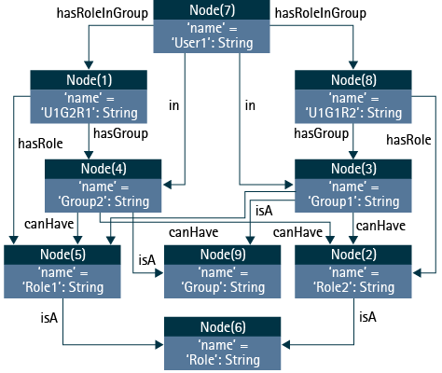
3.12 Specialty Data Processing Example
Specialty data processing solutions tackle highly complex data that is large, densely connected, and semi-structured (essentially a hash-map on each element). Specialty data is accessed directly via Java®, and many graph algorithms are included out-of-the box. It can facilitate complex queries with a graph query language such as Gremlin, and can provide support for Spring with Spring Data.
46

Slide 47
3.13 In-Memory Processing
Databases that reside in computer memory rather than hard disks, and the associated technologies, will lend cutting-edge capabilities for enterprise software in the future. This “in-memory” computing technology has been gaining ground, will speed up data crunching, and will help meet the diverse information and analytics requirements of companies faster than before.
Characteristics | Differences
Overcome traditional system bottlenecks of disk reads/writes Leverage lots of memory, sometimes distributed across a cluster Save information in disks asynchronously Proprietary (in most cases) | In-memory processing is all about speed of processing at large scale: Distributed in-memory cache access Distributed in-memory Online Analytical Processing (OLAP) In-memory Message Passing Interface (MPI) distributed analytics
Uses | Products/Vendors
Real-time feed ingestion and analysis Real-time high-volume trading systems Mobile content/ringtone hosting applications Machine/sensor data for real-time analytics | VoltDB; systems, applications, and products in data processing; and high performance analytic appliance systems, applications, and products (SAP® HANA) QlikView®, SolidDB®, Membase®, STORM, Spark, Flink, Kinesis DRUID® (Metamarkets), Statistical Analysis System (SAS HPA), and GemFire®
47

Slide 48
3.14 Analytics Database and Appliances
Analytics database and appliance solutions consist of an integrated set of servers, storage, operating systems, database management systems, and software pre-installed and pre-optimized specifically for data warehousing.
Characteristics | Differences
Scalable proprietary databases running complex queries Columnar databases with high data compression Packaged hardware/software optimized for data processing | Low maintenance solution in a box Full Structured Query Language (SQL) interfaces for writing complex queries Built in statistical and scientific functions, path analysis, clustering Faster performance
Uses | Products/Vendors
Analyze large volume of mainly structured data efficiently Build complex analytical applications for structured data Large-scale parallel data warehousing with more structured data | Greenplum®, Teradata® Aster, Kognitio Vertica, ParAccel, Sybase® IQ Netezza®, IBM® Insights, Cloudera®, Hortonworks®, Exadata appliance
48

Slide 49
3.15 Presentation and Reporting
To capture and communicate insights from Big Data analytics, we must move from standard reporting to more sophisticated visualization. Visualization is the technique of presenting information in such a way that people can consume it effectively. This involves technologies used for creating images, diagrams, or animations to communicate, understand, and improve the results of Big Data analysis. The most impactful visualizations are often the most interactive, as they give the user the opportunity to explore—and essentially have a conversation with—the data.
Consult the table below to learn more about the move from standard reporting to sophisticated visualization.
Reporting | Visualization
Charts and graphs to depict defined information | Representations to visually explore information
Drill-down techniques to see more details about an attribute | Higher degree of interactions for uncovering insights from data
Limited to defined reports and metrics | Flexible for modeling, analysis, forecasting, and predictions
Data queries | Programmable for visual queries and representations
Reporting Tool: Tables, graphs, charts, and dashboards | Visualization Tool: Dials, gauges, heat maps, overlay, mapping, map zooming, re-visualization, time-based playback, constellation graphs, spatial images, brushing, interactivity, and alerts
49

Slide 50
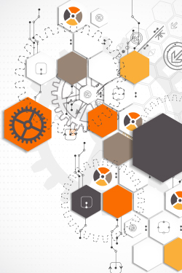
3.16 Big Data Visualization Challenges
Current Big Data visualization challenges include:
Meeting the need for speed (i.e., visualizations displaying real-time results)
Understanding and knowing how to interpret data
Determining data quality and assessing whether or not it is reliable
Displaying meaningful results that can be used to solve business problems
Determining the best design display for the data: graphical or tabular
50

Slide 51
3.17 Checkpoint
Which of the following Big Data technologies monitors and analyzes streaming data in order to identify and respond to changing circumstances in real-time?
Select the best answer, and click or tap the Submit button.
Data Storage and Processing
Low-Latency Non-Relational Databases
Streaming, Complex Event Processing
Specialty Data Processing
In-Memory Processing
51

Slide 52
3.17 Checkpoint Answer
Which of the following Big Data technologies monitors and analyzes streaming data in order to identify and respond to changing circumstances in real-time?
Select the best answer, and click or tap the Submit button.
Data Storage and Processing
Low-Latency Non-Relational Databases
Streaming, Complex Event Processing
Specialty Data Processing
In-Memory Processing
The correct answer is C.
A major component of Big Data is streaming, event-based data, such as news stories, social media posts, or stock market feeds. The goal of complex event processing is to monitor and analyze this streaming data in order to identify and respond to changing circumstances in real-time.
52

Slide 53
3.18 Module Summary
The following key points were covered in this module:
Apache® Hadoop® is one of the leading frameworks for data storage and processing and addresses a variety of Big Data storage and processing requirements.
The Apache® Spark™ framework performs general data analytics on distributed computing clusters like Hadoop®, and it provides in-memory computations for increased speed and data processing over MapReduce.
Because of its sheer size and lack of structure, traditional relational-based databases (RDBMS) cannot handle Big Data, which requires a more flexible non-relational structure that supports fast access to data for processing.
Non-relational databases have a number of special features to handle Big Data: key value pairs, and column-oriented, document-based, and graph-based databases.
Complex event processing monitors and analyzes streaming, event-based data such as news stories, social media posts, and stock market feeds to identify and respond to changing circumstances in real-time.
One-, two-, and three-dimensional processing models manage highly complex, densely connected, and semi-structured specialty data types.
In-memory computing technology has been gaining ground, will speed up data crunching, and will help meet the diverse information and analytics requirements of companies faster than before.
Analytics database and appliance solutions consist of an integrated set of servers, storage, operating systems, database management systems, and software pre-installed and pre-optimized specifically for data warehousing.
Big Data analytics requires a move from standard reporting to more sophisticated visualization techniques to present information in such a way that people can consume it effectively to learn about and solve business problems.
53

Slide 54
Module 4: Working with Big Data

Slide 55
4.1 Module Introduction
Working with Big Data requires new ways of looking at data management and analytics. Implementing the technologies for storing and processing Big Data discussed in the previous module is not enough; organizations need to examine and update their approaches and resources for managing and extracting insights from the data.
By the end of this module, participants will be able to:
Discuss unique considerations for managing Big Data
Provide examples of the roles and skillsets required to work with and extract insights from Big Data
Compare Big Data and traditional analytics approaches
Identify several advanced visualization tools and techniques that can be used with Big Data
55

Slide 56
4.2 Data Management Considerations for Big Data (1/2)
Accenture’s Data Management perspective is a holistic, multi-pillar view across people, processes, and technology. Big Data affects these pillars and any changes to traditional approaches need to be investigated and implemented. The goal of Big Data management is to ensure a high level of data quality and accessibility for business intelligence and analytics applications. Corporations, government agencies, and other organizations employ Big Data management strategies to help them contend with fast-growing pools of data, typically involving many terabytes to petabytes of information saved in a variety of file formats. Effective Big Data management helps companies locate valuable information in large sets of unstructured data and semi-structured data from a variety of sources including call detail records, system logs, and social media sites.
Master and Meta Data Management | Data Quality | Data Structure
Master data is the fundamental business data in an enterprise. Master data is typically long-lived and used across multiple applications. Master data is primarily developed in-house and is enriched with information extracted from analyzed, unexplored, unstructured data. Seamless integration of meta data in unstructured content with traditional meta data management will have to be undertaken. | Data quality is the ability of data to satisfy the stated business, system, and technical requirements of the organization. Data quality is typically measured in terms of completeness, timeliness, accuracy, consistency, relevance, and integrity. In the context of Big Data, data quality is driven by use cases; applications will not have the same level of quality expectations. For example, clickstream analysis and intrusion detection do not require the same level of precision. Data quality rules and policies, compliance rules, and data cleansing standards will need to be assessed in this context. | Data structure is how data is organized in a specific enterprise. Data structure includes multiple levels of an enterprise ranging from overall corporate data models down to the level of an individual system. In the context of Big Data, data structure is affected primarily because of data diversity. Data taxonomies and logical data models will need to accommodate unstructured content and the processes of extracting structure from them.

Slide 57
4.2 Data Management Considerations for Big Data (2/2)
Data Security | Data Architecture | Data Governance
Data security is the processes and technology to protect data from unauthorized access, viewing, modification, or deletion whether the intent is accidental, intentional, or malicious. With the integration of diverse data sources (internal and external), appropriate compliance and security policies will need to be put in place and adherence to local, national, and international laws will need to be analyzed and standardized. New tools for the security of unstructured data will need to be leveraged. | Data architecture is the processes, systems, and human organizations required to store, access, move, and organize data. Data sizing, storage, and movement architecture is going through a change. Data retention and deletion policies are being updated. Physical data models are revamped to accommodate a hybrid environment. | Data governance defines how an enterprise manages its data assets. Governance includes the rules, policies, procedures, roles, and responsibilities that guide overall management. Governance provides guardrails so data is accurate and consistent, complete, available, and secure. Data policies and data standards require updates for unstructured diverse data sources. Business data ownership will need to be redefined for new and external data sources. Corresponding data workflows will be affected. Master Data Management (MDM) programs will ultimately need to govern the relationships between internal data and Big Data from external sources.
57

Slide 58
4.3 Big Data Roles (1/3)
Consult the table below for more information on the various roles that work with Big Data.
ETL (Extract, Transfer, Load) Developers | ETL Developers mainly work with different sources of data an organization may have. They create ways to extract data from sources, as well as to import and modify it to fit the needs of the organization. Then they add the data into a data warehouse.
Hadoop® Developers | Hadoop® is a Java® -based, open source framework that supports the processing of large data sets. Hadoop® Developers write map-reduce programs using Java®, Python™, and other technologies including Spark™, Hive™, HBase™, MapReduce, Pig, and so on.
Visualization Tool Developers | Massive amounts of data can prove challenging to analyze. Visualization Tool Developers create new types of visualization toolsets like Spotfire®, QlikView®, MicroStrategy®, Datameer®, Platfora®, IBM® Insights, and Tableau® to allow for intuitive and speedy data probing.
Data Scientists | Previously referred to as Data Architects who were a part of IT, the Data Scientist is a new breed of technology professional able to tie their data organization techniques into business value propositions.
OLAP Developers | Online Analytical Processing (OLAP) Developers are experts in the optimization of data organization. This is the process of taking data from relational or non-structured data sources and creating dimensional models.
Data Warehouse Appliance Specialist | Data Warehouse Appliance Specialists specialize in appliances such as Cloudera®, IBM® BigInsights™, Hortonworks®, MapReduce, Teradata®, Netezza®, and Exadata®. The core responsibilities associated with this role include data integration, administration, and optimization of performance associated with these high-end machines. These special appliances are used in an organization to provide Massive Parallel Processing (MPP) by using optimized memory, disk, and data storage architectures specific to an analytics processing environment.
58

Slide 59
4.3 Big Data Roles (2/3)
Predictive Analytics Developer | Predictive analytics are used in marketing organizations to predict consumer behavior and target product audiences. Similar to the Data Scientist in the exploratory nature of what they do, Predictive Analytics Developers examine many "what if?" scenarios associated with an organization’s data.
Information Architect | An Information Architect plans and designs websites and web applications to ensure a positive user experience. Their focus is on the target audience, the technologies used to create sites, and the actual site content. An Information Architect organizes information and design strategies using data from usability testing on how users interact with a company’s communications systems.
Chief Data Officer | A Chief Data Officer is responsible for enterprise-wide governance and the use of information as an asset through data processing, analysis, data mining, and information trading.
Data Analyst | A Data Analyst coordinates with customers and staff and provides support for all data analysis. They perform data analysis on all results and prepare presentations for clients.
Big Data Visualizer | Big Data Visualizer provide value-add analysis to organizations using visualization software to guide analysis, draw implications from analysis, and synthesize the information into clear communications. They understand how data flows within various systems to provide input on requirements for databases to ensure data is organized properly for reporting and analytics.
Big Data Solutions Architect | A Big Data Solutions Architect guides the full life cycle of a Hadoop® solution, including requirements analysis, platform selection, technical architecture design, application design and development, testing, and deployment.
Big Data Engineer | Big Data Engineers design, build, and manage the information (Big Data) infrastructure. They develop the architecture to analyze and process data, and they ensure optimum performance of those systems.
59

Slide 60
4.3 Big Data Roles (3/3)
Big Data Researcher | Big Data Researchers extract data from a variety of relational databases, and manipulate and explore data using quantitative, statistical, and visualization tools. They also inform the selection of modeling techniques to ensure that predictive models are developed using rigorous statistical processes.
Data Warehouse Manager | A Data Warehouse Manager develops and implements information management strategies; coordinates and manages information management solutions; and manages all aspects of the warehouses such as data sourcing, migration, quality, design, and implementation.
Data Architect | A Data Architect designs, creates, deploys, and manages an organization's data architecture. They define how the data will be stored, consumed, integrated, and managed by different data entities and IT systems, and any applications that use or process that data.
Database Manager | A Database Manager determines how information is managed, organized, stored, and accessed. They improve the effectiveness of the database tools and services, ensure all data complies with legal regulations, and make sure the information is protected and backed-up.
Business Intelligence Analyst | Business Intelligence Analysts gather data by using mining computer data and by looking at competitor data and industry trends to develop a picture of where the company stands in the industry, how they can improve, and where they can reduce costs.
60

Slide 61
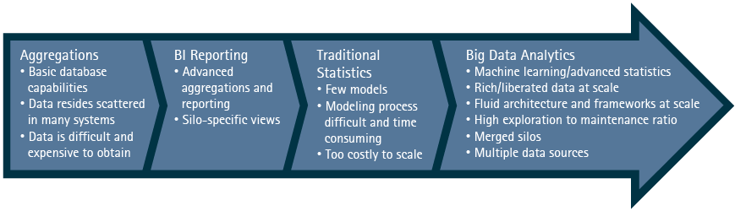
4.4 From Basic Analytics to Big Data Analytics
Big Data analytics is an augmentation to an existing analytical infrastructure that allows organizations to scale and drive insights above and beyond current capabilities.
61

Slide 62
4.5 Big Data Analytics
Big Data Analytics has certain features that are not part of traditional analytics.
Distributed Batch Execution Frameworks | Real-Time Metrics and Trends | Large-Scale Machine Learning
Rescoring Large-scale queries Central data archive Data agility (structured and unstructured data) | Real-time recommendations Real-time offers Real-time optimizations | Explore large datasets Extraction from millions of features Large-scale models
62

Slide 63
4.6 Comparing Traditional and Big Data Analytics
Traditional analytics is the activity of discovering data insights. Big Data analytics is the activity of exploring, discovering, and sharing insights in poly-structured data regardless of size, location, or incoming speed.
Consult the table below to learn more about the differences between traditional and Big Data analytics.
Traditional Analytics | Big Data Analytics
Structured, Centralized, Controlled | Poly-Structured, Distributed, Low Control
Curated, Summarized, Sampled | No Pre-Defined Relations, Complex, Deep
Contained and Predictable | Experimental and Exploratory
Hierarchical Organization, Process-Driven | Flat Hybrid Organization, Self-Serve
Proprietary, Expensive | Open Sourced, Cost Smart
Data Movement, Batch-Oriented | Real-Time, In-Database
63

Slide 64
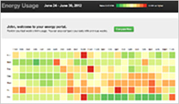
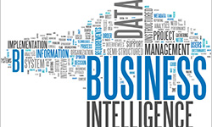
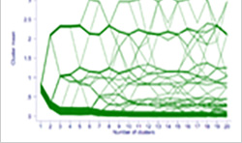
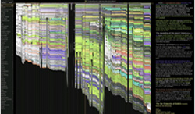
4.7 Presenting Analytics: Advanced Data Visualization
Advanced data visualization is successful because it capitalizes on our visual advantage to recognize and understand patterns, represents a large amount of data in one place, and gives users access to actionable insights.
A heat map uses color to represent a data value. Patterns in concentration can be shown by using the position and color elements. This example shows a household’s energy usage over time. It becomes very easy to interpret the days when the household energy usage would be less or more.
Text can be visualized in the form of a tag cloud or a weighted visual list. The words that appear more frequently will be larger than those which are used less frequently. A reader is quickly able to perceive the most salient concepts represented in large text.
Heat Map
Tag Cloud
Individual members of a dataset are assigned to clusters. The choice of the number of clusters is an important parameter in cluster analysis. This technique allows the analyst to reach a better understanding of how the results of clustering vary with a different number of clusters.
History flow charts the evolution of a document as it is edited by multiple authors. Time appears as the horizontal axis, while contribution to the text is on the vertical axis. Each author has a different color code, and the length of the bar indicates the amount of text by each author.
Clustergram
History Flow
64

Slide 65
4.8 Checkpoint
Which of the following are features of Big Data analytics and were not part of traditional analytics?
Select all that apply, and click or tap the Submit button. There will be more than one answer.
Distributed batch execution frameworks
Real-time metrics and trends
Large-scale machine learning
OLAP cubes
65

Slide 66
4.8 Checkpoint Answer
Which of the following are features of Big Data analytics and were not part of traditional analytics?
Select all that apply, and click or tap the Submit button. There will be more than one answer.
Distributed batch execution frameworks
Real-time metrics and trends
Large-scale machine learning
OLAP cubes
The correct answers are A, B, and C.
Big Data Analytics has certain features that are not part of traditional analytics. These include distributed batch execution frameworks, real-time metrics and trends, and large-scale machine learning.
66

Slide 67
4.9 Checkpoint
True or False: To capture and communicate insights from Big Data analytics, organizations can use either standard reporting methods or visualization techniques.
Select the correct answer, and click or tap the Submit button.
True
False
67

Slide 68
4.9 Checkpoint Answer
True or False: To capture and communicate insights from Big Data analytics, organizations can use either standard reporting methods or visualization techniques.
Select the correct answer, and click or tap the Submit button.
True
False
The correct answer is False.
To capture and communicate insights from Big Data analytics, we must move from standard reporting to more sophisticated visualization. Visualization is the technique of presenting information through the use of images, diagrams, or animations to communicate, understand, and improve the results of Big Data analysis.
68

Slide 69
4.10 Module Summary
The following key points were covered in this module:
Big Data Analytics has several features that are not part of traditional analytics including distributed batch execution frameworks, real-time metrics and trends, and Large-scale machine learning.
Current Big Data visualization challenges include:
  Meeting the need for speed
  Understanding and knowing how to interpret data
  Determining data quality and reliability
  Displaying meaningful results
  Determining the best design for the data
Traditional analytics is the activity of discovering data insights, while Big Data analytics is the activity of exploring, discovering, and sharing insights in poly-structured data regardless of size, location, or incoming speed.
Big Data analytics requires a move to more sophisticated visualization using images, diagrams, or animations to communicate, understand, and improve the results of Big Data analysis.
Considerations for Big Data management include master and meta data management, data quality, data structure, data security, data architecture, and data governance.
There are a number of various roles that work with Big Data, each with its own set of responsibilities.
Big Data analytics is an augmentation to an existing analytical infrastructure that allows organizations to scale and drive insights above and beyond current capabilities.
Advanced visualization includes the use of heat maps, tag clouds, clustergrams, and history flows.
69

Slide 70
Module 5: Accenture’s Approach to Big Data

Slide 71
5.1 Module Introduction
Accenture is prepared to meet the needs of our clients to harness Big Data to achieve insights and competitive advantage.
Our objectives are to:
Enable our clients to become data-driven with a future state, high-performing, hybrid technology platform that collects and combines structured and unstructured data for integrated, efficient, and cost-effective processing.
Leverage visualization tools, and develop techniques and best practices to enable rapid and differentiated data discovery and insights.
Develop new approaches, tools, and capabilities to enable insight to outcomes in a Big Data environment.
Enable clients to monitor machine-based sensor and device usage data to drive performance enhancements across the enterprise.
By the end of this module, participants will be able to:
Discuss Accenture’s approach to Big Data
Describe the capabilities that exist within the Big Data practice
Identify where to go for more information about how to get started with Big Data
71

Slide 72
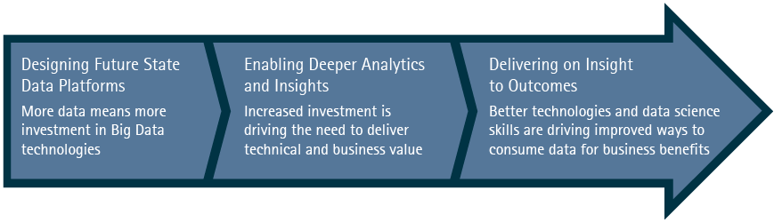
5.2 Accenture’s Impetus for Big Data
There are three guiding forces behind Accenture’s Big Data endeavors: designing future state data platforms, enabling deeper analytics and insights, and delivering on insight to outcomes.
72

Slide 73

5.3 Big Data Analytics Practice
At Accenture Big Data is part of the larger Data Supply Chain community. The Big Data 100 is a group of Big Data experts specialized in providing deep architecture, design, and data science expertise across the entire Accenture ecosystem.
Accenture invests in Big Data technologies and approaches designed specifically to drive value for its clients. Accenture’s goals include bridging R&D labs and delivery and aligning Big Data investment to enable transformational and predictable outcomes.
Accenture enables the integration of open source Big Data technologies with traditional vendor Big Data technologies to enable high-performing enterprise hybrid solution architectures. Accenture has a strong focus on open source technologies such as Hadoop®, which is a large-scale data processing platform.
73

Slide 74

5.4 Big Data Analytics Capabilities
The following capabilities are required to practice Big Data analytics:
Hadoop® platform architecture
Hadoop® application design and development
Hybrid distributed data platform design and development
Analytical design and development at scale
Hadoop® platform integration
Cluster sizing, testing, and development operations
Data Science point of view, proof of concept, and pilots
The Big Data Academy provides a wide range of courses to help build your skills. It offers four tracks depending on your needs and areas of interest: business, technical, analytics, and visualization. Learn more about the Big Data Academy curriculum here.
74

Slide 75
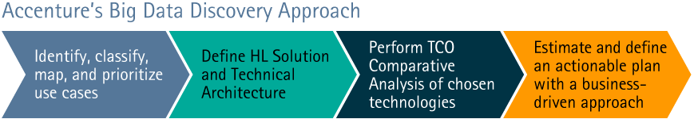
5.5 Getting Started with Big Data
Accenture’s Big Data Discovery service helps organizations identify Big Data opportunities and use cases that are aligned with business stakeholder needs. It helps organizations define a delivery road map and an actionable plan with clear business value delivery goals by phase. Through Discovery, the team defines a conceptual technical and solution architecture design and helps to understand the total cost of ownership (TCO) of the chosen technologies.
75

Slide 76
5.6 Module Summary
The following key points were covered in this module:
There are three guiding forces behind Accenture’s Big Data endeavors: designing future state data platforms, enabling deeper analytics and insights, and delivering on insight to outcomes.
At Accenture, Big Data is part of the larger Data Supply Chain community, the Big Data 100, which is a group of experts specialized in providing deep architecture, design, and data science expertise across the entire Accenture ecosystem.
Practicing Big Data requires a number of capabilities including application design and development and platform architecture and integration.
Accenture’s Big Data Discovery service helps organizations identify Big Data opportunities and use cases, define a delivery road map and an actionable plan, define a conceptual technical and solution architecture design, and understand the total cost of ownership of the chosen technologies.
76

Slide 77
Module 6: Course Conclusion

Slide 78

6.1 Course Summary
You have reached the end of the Introduction to Big Data course.
In this course, you have learned:
There has been a shift in the size, type, and form of data and in the way that data is analyzed.
Organizations using traditional processing techniques are struggling to benefit from the onslaught of Big Data.
Data policies, skills, tools and technologies, data management, and organizational change are potential barriers to Big Data adoption.
Big Data can provide significant potential value including enhanced productivity and efficiency, data-driven insights, better return on investment (ROI), innovative new business services, capital cost reduction, operational efficiency, and mission enhancements.
Big Data impacts core business processes in every industry: resources, public sector, financial services, health, retail, and communications.
Traditional relational-based databases (RDBMS) cannot handle Big Data, which requires a more flexible non-relational structure.
Big Data analytics requires a move to more sophisticated visualization using images, diagrams, or animations to communicate, understand, and improve the results of Big Data analysis.
Accenture’s Big Data Discovery service helps organizations identify Big Data opportunities and use cases, define a delivery road map and an actionable plan, define a conceptual technical and solution architecture design, and understand the total cost of ownership of the chosen technologies.
78

Slide 79
6.2 Resources
Big Data Application Examples
With Satellite Images, Wall Street Analysts Spy on Wal-Mart
IBM-IT Systems, Consulting and Services for the Airport Industry
Twitter Chatter can Predict Stock Prices, Study Finds
Injury Surveillance System: The Case of Newspapers Clippings
Additional Reading:
Why Big Data Needs Visualization to Succeed: https://www.accenture.com/cn-en/insight-why-big-data-needs-visualization-succeed-summary
Masters of the Digital Universe: https://www.accenture.com/cn-en/insight-outlook-masters-of-the-digital-universe-information-technology
Client Case Study: Big Data Management for Large Entertainment Company: https://www.accenture.com/cn-en/success-large-entertainment-company-application-outsourcing
Federal Analytics and Big Data: https://www.accenture.com/cn-en/service-federal-analytics-big-data
79

Slide 80
Appendix

Slide 81
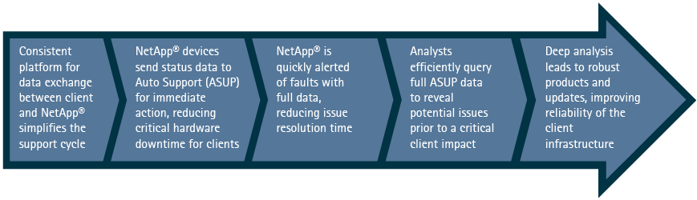
Big Data Value-Add Example: NetApp®
Access to current status and data is crucial to sustaining high quality support for mission critical IT Infrastructure. NetApp® used Big Data to build their auto support system (known as ASUP) that enables proactive issue identification and alerting on their devices. All registered NetApp® devices at client locations “phone home” to the ASUP DB. This ensures that current and complete data is available when addressing support issues.
81

Slide 82
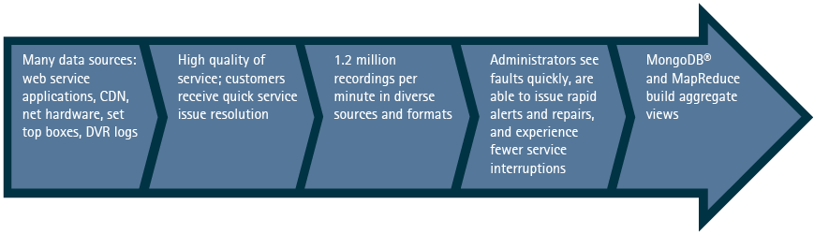
Big Data Value-Add Example: Service Quality
Quality of Service is a key business demand for digital TV providers and presents a number of technical challenges. Tracking infrastructure and client hardware components can generate a range of unstructured data at huge scope and scale. One solution is the visualization of diverse data into aggregate views, which reveal patterns that enable timely issue resolution.
82

Slide 83
Boosting Revenue with Data-Driven Recommendations
Business Need | A global ecommerce company wanted to extend their data science capabilities by computing recommendations at scale on their website. With all recommendation engines, time is top priority. The faster you can compute, the more relevant the results are. The client was looking to pinpoint two key strategies for building a world-class recommendation engine: prediction performance and speed.
Current Challenges | Improve effectiveness of recommendation engine by 10% Resolve difficulty computing recommendations at the user-level due to the large volume of data Increase workable sample size to scale up dataset
Technologies Used | Hadoop®, HDFS MapReduce Hive™, Hbase™, Pig | DataStax® Cassandra DataStax® Enterprise Postgres RDBMS | ETL Integration Mahout™ Azkaban®
Solution Highlights | The retailer was able to use a recommended engine architecture to increase their revenue over 10%, which equated to roughly 300 million dollars. The client was also able to keep a historical track record of over 100GB per day in real-time. This data was then used for reporting metrics on their clickstream data. Solution highlights included: Recommendation as a service layer Recommendations to all departments Real-time log processing Real-time recommendations Large-scale machine learning Data and processing on S3® and EMR in AWS®
83

Slide 84
Real-Time Customer Analysis
Business Need | A large U.S. bank had multiple online banking applications across three global data centers. Each user action in the online application system was tracked, generating approximately 200 million messages per day, which were required to be logged and replicated globally to allow for further customer and application analysis.
Current Challenges | The current infrastructure could not keep up with the pace of processing this data at four hour intervals per the original design. The existing RDBMS, Informix®, was also unable to provide a sustainable geo-redundant capability, leaving the bank vulnerable during planned down times at different data centers. There was a need for active geographic redundancy to attain necessary resiliency and more immediate access to data regardless of original location. The bank wanted the ability to perform near real-time analysis of incoming data and required a capability to achieve continuous high data ingestion speed of 5,000 messages per second or higher.
Technologies Used | Hadoop®, HDFS, Hive™ MapReduce | Thrift™ Cassandra | MQ Series for storing messages WebSphere® MDB
Solution Highlights | A solution leveraging a non-relational data store (Cassandra) to increase performance and meet business objectives was proposed to address the client’s business needs. Solution highlights included: A Cassandra data model to support high speed writes and reads A high volume ingestion and extraction process using Hector and Thrift™ interfaces A Cassandra cluster designed and configured across two geographically distant physical data centers 6TB of data storage across an 18 node cluster PHP clients for near real-time querying of operational data

Slide 85

Value Levers: Financial Services Industry
The financial services industry has been experiencing weak economic growth and regulatory uncertainty. They are also facing declining loyalty, competitive threats, and huge pressures on profitability and growth.
Financial services companies use Big Data for risk modeling, customer churn analysis, recommendation engines, and threat analysis (fraud detection).
Emerging trends with Big Data in the financial services industry include:
Marketing partnerships to develop enhanced customer profiles
Targeted offers to cross-sell and up-sell
Performance marketing to improve promotion effectiveness
Improving 360 degree customer view by leveraging multiple sources of unstructured data
Customer retention
Manage credit risks
Fraud detection and analysis
Sales force productivity and effectiveness
Trade portfolio performance and optimization
85

Slide 86

Value Levers: Retail and Consumer Goods Industry
Consumer spending has been under pressure in the retail and consumer goods industry. Customers are increasingly spending online and through mobile channels, creating tight margins and intense industry competition.
Retail and consumer goods companies use Big Data for marketing campaign analysis, sentiment analysis, point of sale, and trade surveillance. As such, Big Data is expected to increase productivity by 0.5% a year and increase operating margins by 60%.
Emerging trends with Big Data in the retail and consumer goods industry include:
Large-scale clickstream analytics
Event, location, and behavior-based targeting combining social media data
Sentiment analysis
Cross-selling, market basket analysis, and ad targeting
Deep consumer segmentations
Merchandizing and optimization
Supply chain management and analytics
New services such as price comparisons or virtual markets
Operational transparency
86

Slide 87

Value Levers: Communications, Media, and Technology (CMT) Industry
Traditional CMT business has become commoditized, digital devices and content-rich digital services are ubiquitous, and customer loyalty is diminishing. Therefore, it is critical that CMT companies find new sources of revenue
CMT companies use Big Data for ad targeting, network data analysis, search quality, and data sandboxes.
Emerging trends with Big Data in the communications, media, and technology industry include:
Improve customer experience and retention
Tailor real-time recommendations during customer interactions
Monetize data through value added services
Enhance operational efficiencies by detecting real-time infrastructure bottlenecks
Network and security analytics, intrusion detection with a 360 degree view
87

Slide 88
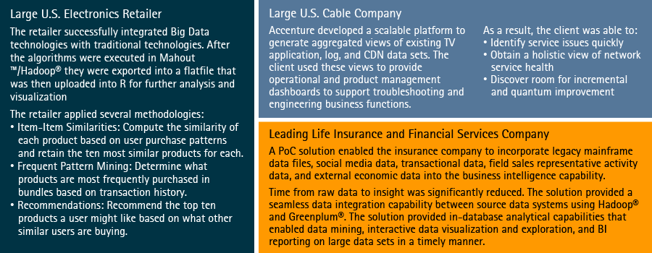
Big Data Analytics Examples
Consult the examples below to see analytics from Big Data in action by means of some common open source software.
88

